Slide 1
Expert intuition:
When can we trust it?
Presented by Olga Snitsar

Slide 2
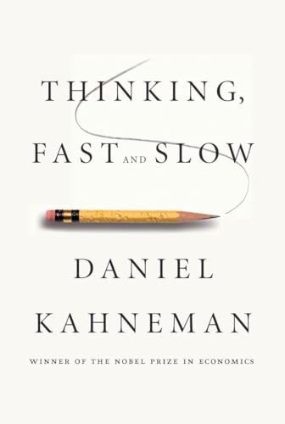
The book
The book's main thesis is a differentiation between two modes of thought:
"System 1" is fast, instinctive and emotional;
"System 2" is slower, more deliberative, and more logical.

Slide 3
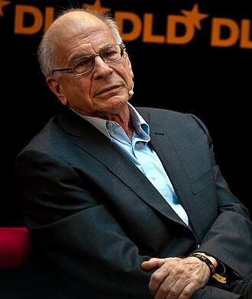
Daniel Kahneman
March 5, 1934 – March 27, 2024
was an Israeli-American author, psychologist and economist notable for his work on hedonic psychology, psychology of judgment and decision-making.
He is also known for his work in behavioral economics, for which he was awarded the 2002 Nobel Memorial Prize in Economic Sciences (shared with Vernon L. Smith).

Slide 4
System 1 vs. System 2
Fast, automatic, frequent, emotional, stereotypic, unconscious
Examples:
determine that an object is at a greater distance than another
localize the source of a specific sound
complete the phrase "war and ..."
display disgust when seeing a gruesome image
solve 2+2=?
read text on a billboard
drive a car on an empty road
Slow, effortful, infrequent, logical, calculating, conscious.
Examples:
prepare yourself for the start of a sprint
direct your attention towards the clowns at the circus
direct your attention towards someone at a loud party
look for the woman with the grey hair
try to recognize a sound
sustain a faster-than-normal walking rate

Slide 5
Who is Garry Klein?
He is a research psychologist famous for pioneering in the field of naturalistic decision making ( NDM).
By studying experts such as firefighters in their natural environment, he discovered that laboratory models of decision making could not describe it under uncertainty.
He studied expertise in fire fighters
He is the author of Recognition-primed decision (RPD) model.

Slide 6
NDM and RPD
Naturalistic decision making (NDM) is concerned with the study of how people make decisions in complex real-world settings that can include dynamic, uncertain and continually changing conditions, and can require real-time decisions in urgent situations with significant consequences.
Recognition-primed decision (RPD) is a model of how people make quick, effective decisions when faced with complex situations. In this model, the decision maker is assumed to generate a possible course of action, compare it to the constraints imposed by the situation, and select the first course of action that is not rejected.

Slide 7
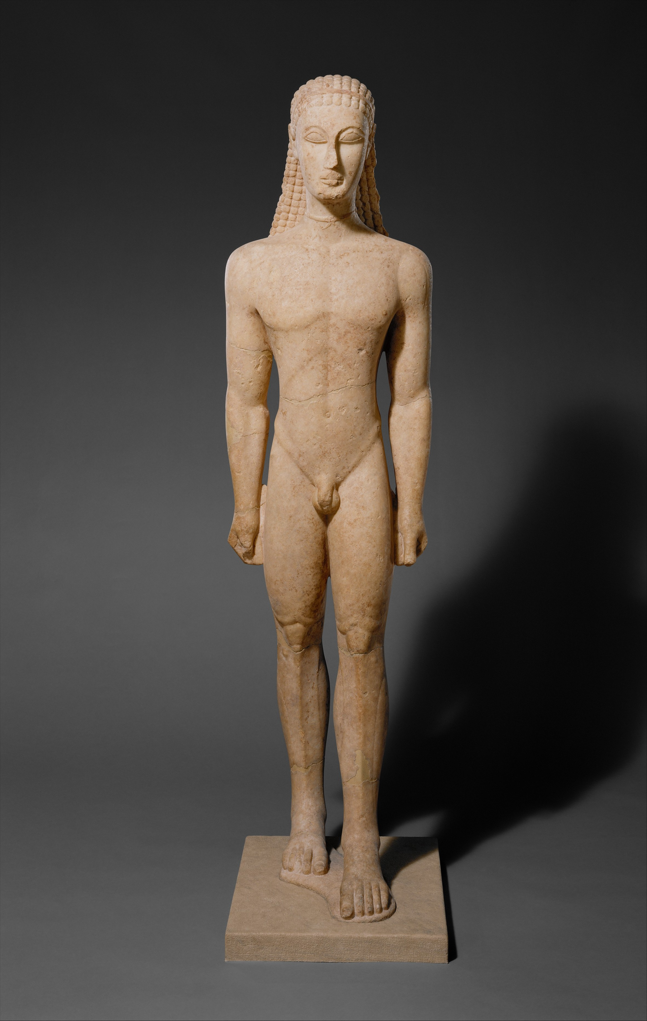
Intuition: Example_1
People know something without knowing how they know.
Good example of intuition :
boy statue kouros from the bestseller “Blink” by Malcolm Gladwell
Many experts agreed that the object that is described as
a magnificent example of a kouros is a fake
and they can’t explain why did they think so.

Slide 8
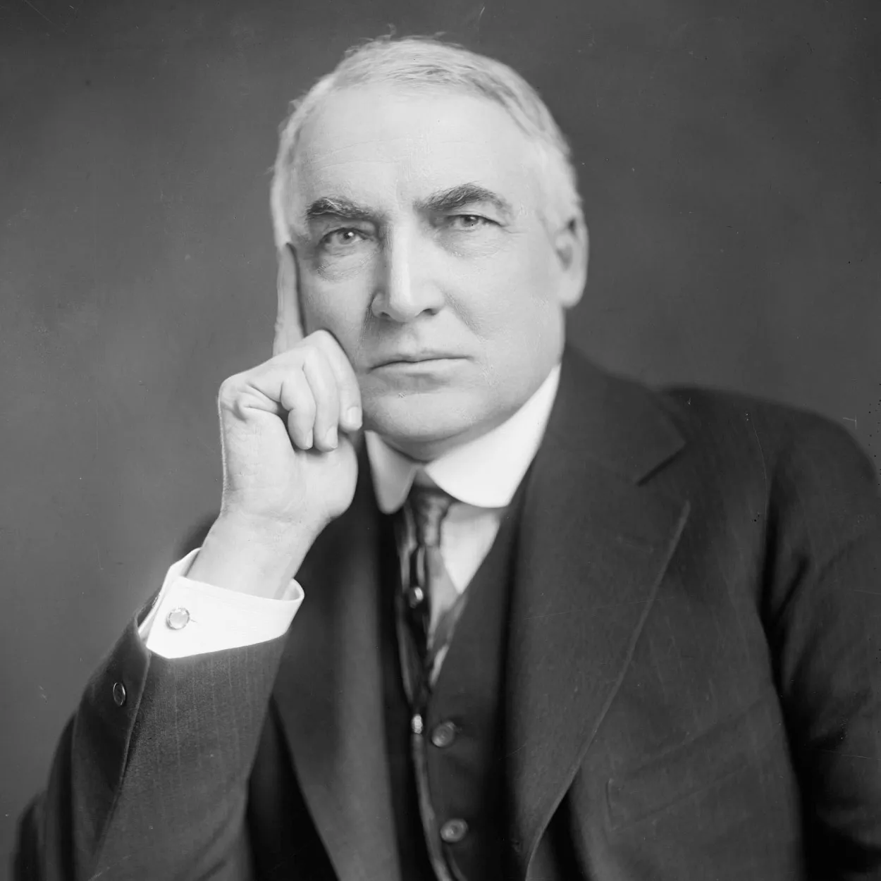
Intuition: Example_2
Intuition failure (appearance vs performance)
President Warren G. Harding, an Ohio Republican,
was the 29th President of the United States (1921-1923)
People looked at his appearance (tall, square jawed)
he was a perfect image if a strong and decisive leader.
“His brief administration accomplished little of lasting value, however, and soon after his death a series of scandals doomed the Harding presidency to be judged among the worst in American history.”
https://www.britannica.com/biography/Warren-G-Harding

Slide 9

Intuition as recognition
Kleins studies of fireground commanders:
he followed them as they fought and later interviewed the leader about his thought as he made decision.
Investigated how commander could make good decision without comparing options
Actually only one decision was made
they evaluated that option based on previous experience (real or virtual)
Simulate it to see if it would work in the situation they were facing
Klein elaborated this description into a theory of decision making that he called recognition-primed decision
RPD also applied to chess players

Slide 10
System 1 and System 2 in RPD
System 1: a tentative plan comes to mind by an automatic function of associative memory.
System 2: plan is mentally simulated to check if it will work
“The situation has provided a cue: this cue has given the expert access to information stored in memory, and the information provided the answer, Intuition is nothing more and nothing less that recognition”- Herbert Simon.
intuitive decision making = pattern recognition.

Slide 11
Acquiring skills
How does the information that supports intuition get “stored in memory”
if an unpleasant event happened previously, the place where it have happened might cause associations with that event (consciously or unconsciously)
similar to Pavlov’s famous conditioned experiment, where dogs learned to recognize the sound of the bell as a signal that food was coming
Expertise takes a long time to develop
A large collection of mini skills (not a single skill) in the case of chess, basketball, fire fighting
Chess: 10,000 hours of practice (6 years, 5 hours/day)
Chess masters can read chess situation at a glance

Slide 12
The environment of skills
When can you trust a self-confident professional who claims to have an intuition ? The answer comes from the two basic conditions for acquiring a skill:
Two basic conditions for acquiring a skill:
The environment that is sufficiently regular to be predictable
An opportunity to learn these regularities through prolonged practice
When both of these conditions are satisfied, intuitions are likely to be skilled BUT some environment are worse than irregular…
Typhoid patient example : a physician had an intuition about patients who were about to develop a typhoid . He palpating the patient’s tongue without washing his hands between patients ( in the early twentieth century)
so , patients became ill, but the doctor developed the sense of clinical infallibility
His predictions were accurate, but not because he was exercising professional intuition!

Slide 13
Feedback and practice
Important:
Quality and speed of feedback
Sufficient opportunity to practice
Examples:
Driving a car/ mastering the skill of taking curves : gradually learn when to let go of the accelerator and when and how hard to use the breaks. Conditions for learning this skill is ideal because of immediate and unambiguous feedback ( comfortable vs unconformable turn)
Harbor pilot maneuvering large ship, skill much more difficult to acquire because there is a long delay between actions and noticeable outcome
Anesthesiologist vs. radiologist
Anesthesiologist in better position to develop useful intuitive skills: effects of their actions are likely to be quickly evident
Radiologist: obtain little information about the accuracy of diagnoses they make and about the pathologies they failed to detect

Slide 14
Evaluating validity: When we can trust an experienced professional who claims to have an intuition?
If the environment is sufficiently regular and if the judge ha s had a chance to learn its regularities , the associative machinery will recognize situations and generate quick and accurate predictions and decisions
In a less regular (or low-validity ) environment the heuristic of judgment are invoked.
System 1 substitute intendent question by another one and answer for that question is produced quickly and may be sufficiently plausible to pass the lax and lenient review of the System 2.
Example: commercial future of a company vs energy and competence of its current executives.
Subjective confidence is NOT a good diagnostic of accuracy: Judgments that answer the wrong question can also be made with high confidence.

Slide 15
Summary
Recognition-Primed Decision (RPD) Model:
Klein proposed the RPD model, which applies not only to firefighting but also to other domains like chess.
In this model, a tentative plan arises from associative memory in System 1 (fast thinking).
The next phase involves a deliberate process where the plan is checked by System 2 (slow thinking).
Kahneman believes this kind of intuition is essentially recognition of information stored in memory.

Slide 16
Summary
Blurring the Line Between Intuition and Memory:
Klein’s work challenges the traditional view of intuition.
Instead of relying solely on intuition to generate new plans, experts often recall previous situations they’ve encountered.
This blurs the line between intuition and memory, emphasizing the role of experience.
Remember that intuition isn’t always reliable, and understanding when to trust it versus when to rely on deliberate thinking is crucial.

